Slide 1
Blacktown Chinese Christian Church
Welcome to Our English Service 27.07.2025
English Service 9:45 – 11:00 am
Worship Songs: Passage: Speaker: Topic: Response Song: Announcements and Closing Prayer Benediction
Confidence Great is thy faithfulness 10000 reasons Daniel 9:4-19 Jenny Williams Daniel : A Calling to Fulfill TBA

Slide 2
BCCC english service

Slide 3

Please keep all phones on silent

Slide 4
Confidence
CCLI Licence No: 5485849

Slide 5
I'm not a warrior, I'm too afraid to lose
I feel unqualified for what You're calling me to
But Lord with Your strength, I've got no excuse
'Cause broken people are exactly who You use

Slide 6
So give me faith like Daniel in the lion's den
Give me hope like Moses in the wilderness
Give me a heart like David, Lord be my defense
So I can face my giants with confidence

Slide 7
You took a shepherd boy and made him a King
So I'm gonna trust You and give You everything
I'll be a conqueror, 'cause You fight for me
I'll be a champion claiming Your victory

Slide 8
So give me faith like Daniel in the lion's den
Give me hope like Moses in the wilderness
Give me a heart like David, Lord be my defense
So I can face my giants with confidence

Slide 9
I'm gonna sing and shout and shake the walls
I won't stop until I see them fall
I'm gonna stand up, step out when You call
Jesus, Jesus

Slide 10
I'm gonna sing and shout and shake the walls
I won't stop until I see them fall
I'm gonna stand up, step out when You call
Jesus

Slide 11
Give me faith like Daniel in the lion's den
Give me hope like Moses in the wilderness
Give me a heart like David, Lord be my defense
So I can face my giants with confidence

Slide 12
Give me faith like Daniel in the lion's den
Give me hope like Moses in the wilderness
Give me a heart like David, Lord be my defense
So I can face my giants with confidence

Slide 13
I'll face my giants with confidence

Slide 14
Great Is Thy Faithfulness
CCLI Licence No: 5485849

Slide 15
Great is Thy faithfulness, O God my Father
There is no shadow of turning with Thee
Thou changest not, Thy compassions, they fail not
As Thou hast been, Thou forever will be

Slide 16
Great is Thy faithfulness, Great is Thy faithfulness
Morning by morning new mercies I see
All I have needed Thy hand hath provided
Great is Thy faithfulness, Lord, unto me

Slide 17
Summer and winter and springtime and harvest
Sun, moon and stars in their courses above
Join with all nature in manifold witness
To Thy great faithfulness, mercy and love

Slide 18
Great is Thy faithfulness
Great is Thy faithfulness
Morning by morning new mercies I see

Slide 19
All I have needed Thy hand hath provided
Great is Thy faithfulness, Lord, unto me

Slide 20
Pardon for sin and a peace that endureth
Thine own dear presence to cheer and to guide
Strength for today and bright hope for tomorrow
Blessings all mine, with ten thousand beside

Slide 21
Great is Thy faithfulness
Great is Thy faithfulness
Morning by morning new mercies I see

Slide 22
All I have needed Thy hand hath provided
Great is Thy faithfulness, Lord, unto me

Slide 23
10000 Reasons (Bless The Lord)
CCLI Licence No: 5485849

Slide 24
Bless the Lord oh my soul
Oh my soul
Worship His Holy name

Slide 25
Sing like never before
Oh my soul
I'll worship Your Holy name

Slide 26
The sun comes up
It's a new day dawning
It's time to sing Your song again

Slide 27
Whatever may pass
And whatever lies before me
Let me be singing
When the evening comes

Slide 28
Bless the Lord oh my soul
Oh my soul
Worship His Holy name

Slide 29
Sing like never before
Oh my soul
I'll worship Your Holy name

Slide 30
You're rich in love
And You're slow to anger
Your name is great
And Your heart is kind

Slide 31
For all Your goodness
I will keep on singing
Ten thousand reasons
For my heart to find

Slide 32
Bless the Lord oh my soul
Oh my soul
Worship His Holy name

Slide 33
Sing like never before
Oh my soul
I'll worship Your Holy name

Slide 34
And on that day
When my strength is failing
The end draws near
And my time has come

Slide 35
Still my soul will
Sing Your praise unending

Slide 36
Ten thousand years
And then forevermore
Forevermore

Slide 37
Bless the Lord oh my soul
Oh my soul
Worship His Holy name

Slide 38
Sing like never before
Oh my soul
I’ll worship your holy name

Slide 39
Bless the Lord oh my soul
Oh my soul
Worship His Holy name

Slide 40
Sing like never before
Oh my soul
I’ll worship your holy name

Slide 41
Lord I’ll worship your holy name
I’ll worship your holy name

Slide 42
Sing like never before
Oh my soul
I'll worship Your Holy name
I'll worship Your Holy name

Slide 43
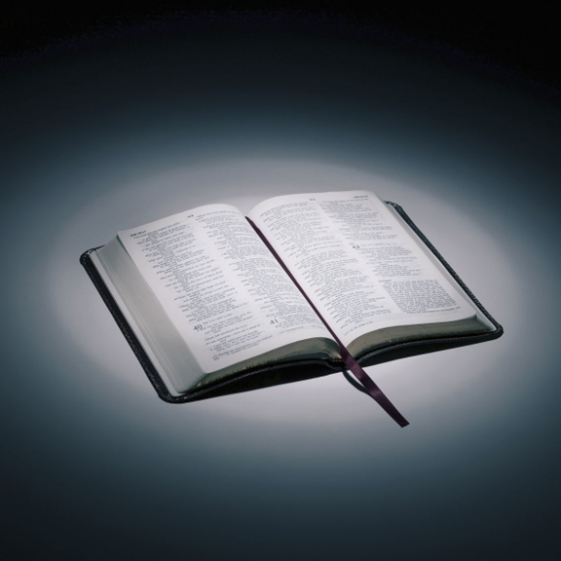
Bible reading

Slide 44
Daniel 9:4-19
⁴ I prayed to the Lord my God and confessed:
“Lord, the great and awesome God, who keeps his covenant of love with those who love him and keep his commandments, ⁵ we have sinned and done wrong. We have been wicked and have rebelled; we have turned away from your commands and laws.

Slide 45
Daniel 9:4-19
⁶ We have not listened to your servants the prophets, who spoke in your name to our kings, our princes and our ancestors, and to all the people of the land.
⁷ “Lord, you are righteous, but this day we are covered with shame—the people of Judah and the inhabitants of Jerusalem and all Israel, both near and far, in all the countries where you have scattered us because of our unfaithfulness to you.

Slide 46
Daniel 9:4-19
⁸ We and our kings, our princes and our ancestors are covered with shame, Lord, because we have sinned against you. ⁹ The Lord our God is merciful and forgiving, even though we have rebelled against him;

Slide 47
Daniel 9:4-19
¹⁰ we have not obeyed the Lord our God or kept the laws he gave us through his servants the prophets. ¹¹ All Israel has transgressed your law and turned away, refusing to obey you.
“Therefore the curses and sworn judgments written in the Law of Moses, the servant of God, have been poured out on us, because we have sinned against you.

Slide 48
Daniel 9:4-19
¹² You have fulfilled the words spoken against us and against our rulers by bringing on us great disaster. Under the whole heaven nothing has ever been done like what has been done to Jerusalem. ¹³ Just as it is written in the Law of Moses, all this disaster has come on us, yet we have not sought the favor of the Lord our God by turning from our sins and giving attention to your truth.

Slide 49
Daniel 9:4-19
¹⁴ The Lord did not hesitate to bring the disaster on us, for the Lord our God is righteous in everything he does; yet we have not obeyed him.
¹⁵ “Now, Lord our God, who brought your people out of Egypt with a mighty hand and who made for yourself a name that endures to this day, we have sinned, we have done wrong.

Slide 50
Daniel 9:4-19
¹⁶ Lord, in keeping with all your righteous acts, turn away your anger and your wrath from Jerusalem, your city, your holy hill. Our sins and the iniquities of our ancestors have made Jerusalem and your people an object of scorn to all those around us.
¹⁷ “Now, our God, hear the prayers and petitions of your servant. For your sake, Lord, look with favor on your desolate sanctuary.

Slide 51
Daniel 9:4-19
¹⁸ Give ear, our God, and hear; open your eyes and see the desolation of the city that bears your Name. We do not make requests of you because we are righteous, but because of your great mercy. ¹⁹ Lord, listen! Lord, forgive! Lord, hear and act! For your sake, my God, do not delay, because your city and your people bear your Name.”

Slide 52
Announcements

Slide 53





Account name: Blacktown Chinese Christian Church
Account number: 4216 50263
Offering
BSB: 112 - 879
Please put in "offering" as the reference
The offering box is available at the back of the hall

Slide 54
Prayer points

Slide 55
Mingle time!

